Slide 1
ALT 2025
Long-Short Momentum Factor Strategy
DRIVING SUCCESS WITH STRATEGIC ALGORITHMIC TRADING
CARIS ANTONY MAMPILLY
+1 283.210.9609

Slide 2

ALT 2025
Executive Summary
A DISCIPLINED, DATA-DRIVEN MOMENTUM STRATEGY DELIVERING CONSISTENT ALPHA THROUGH MARKET-NEUTRAL, FACTOR-BASED INVESTING.
Objective: Build a market-neutral, factor-based long-short equity strategy using momentum factor exposure (beta_umd).
Methodology: Estimate 60-day rolling betas using the Fama-French 5-Factor + UMD model. Go long top 5 and short bottom 5 stocks by momentum beta each month.
Data: Top 25 tech stocks in the S&P 500, with daily data from Alpaca (2019–2024).
Performance: Cumulative return of 17.69% and Sharpe ratio of 0.24 over 5+ years.
Conclusion: Momentum beta is a viable alpha signal. Strategy performs well in trending regimes, but benefits from enhancements like volatility scaling or multi-factor integration.

Slide 3

ALT 2025
Strategy Methodology
SYSTEMATIC PORTFOLIO CONSTRUCTION DRIVEN BY MOMENTUM FACTOR
Use Fama-French 5 + Momentum model to estimate factor sensitivities
Run 60-day rolling regressions for each stock to extract beta_umd
Rank stocks monthly by beta_umd
Long top 5, short bottom 5, equal weight
Rebalance monthly, market-neutral structure

Slide 4

ALT 2025
Data Collection & Sources
Data for this strategy was sourced from Alpaca's API for daily stock prices and Ken French’s data library for Fama-French 5-Factor plus Momentum (UMD) factor data.
25 LARGE-CAP TECH STOCKS
DAILY PRICE DATA VIA ALPACA API (2019–2024)
FAMA-FRENCH 5-FACTOR + UMD FROM KEN FRENCH'S DATA LIBRARY

Slide 5
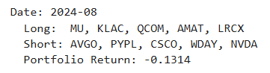
ALT 2025
Monthly Portfolio Summary
CONSISTENT SIGNAL APPLICATION
STABLE STOCK SELECTION:
Strategy systematically applied β_umd each month to construct long-short portfolios using a rules-based framework.
Frequently long: LRCX, KLAC, AMAT, MU, NVDA
Frequently short: INTC, PYPL, WDAY, CSCO
Indicates strong signal stability across time.
REGIME-ALIGNED PERFORMANCE:
Underperformance during COVID shock and 2021–2022 volatility
Strong momentum recovery in mid-2023 onward
High-return months: +21.7% (May 2023), +23.8% (June 2024)

Slide 6

ALT 2025
Performance Metrics
SHARPE RATIO: 0.24
CUMULATIVE RETURN: 17.69%
REBALANCING: MONTHLY
POSITIONING: MARKET-NEUTRAL, EQUAL-WEIGHTED
Indicates moderate risk-adjusted performance; returns were positive but came with some volatility.
Total portfolio growth over the backtest period (2019–2024), without leverage or optimization.
Portfolio positions were updated every month based on the latest β_umd rankings.
Long and short sides were equally weighted to eliminate market beta exposure.

Slide 7
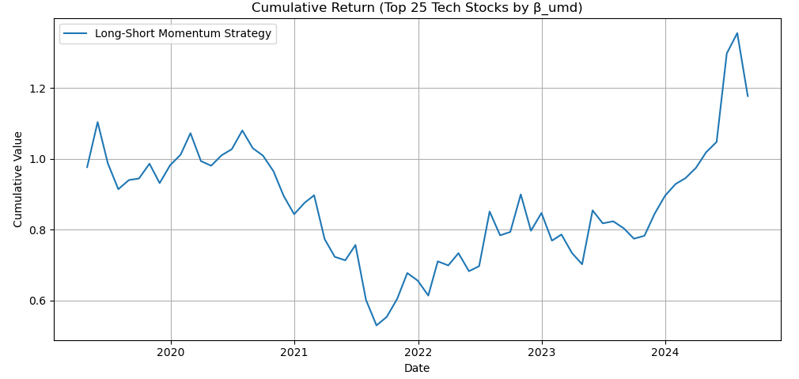
ALT 2025
Long-Short Momentum Strategy Chart
INVESTMENT
Initial period (2019–2020): Slight positive drift, strategy hovered around breakeven.
2021 downturn: Noticeable drawdown, likely due to reversal in momentum premiums or crowded trades during COVID recovery phase.
2022–early 2023: A sideways, choppy regime, with momentum failing to dominate.
Late 2023–2024: Strong uptrend and performance recovery, boosting cumulative returns to new highs.

Slide 8


ALT 2025
Conclusion
Over the 2019–2024 backtest, achieved a cumulative return of 17.69% and a Sharpe ratio of 0.24.
Performance was consistent with momentum behavior:
Strong gains in trending markets (notably 2023–2024)
Drawdowns during reversals or volatile regimes (especially 2021–2022)
Demonstrated that momentum exposure (β_umd) is a viable predictive signal, even within a narrow mega-cap universe.
The modest Sharpe ratio indicates opportunity for enhancement:
Add volatility scaling
Include additional factors (e.g., value, profitability)
Expand universe to improve cross-sectional dispersion

Slide 9

ALT 2025
Outcome to the investor
Over a 5-year back test (2019–2024), it delivered:
+17.69% cumulative return
Sharpe ratio of 0.24 (without leverage or optimization)
Positions were equally weighted, rebalanced monthly, and structured with zero net market exposure.
The signal performed best in trending regimes (e.g., 2023–2024) and remained stable across different market conditions.

Slide 10
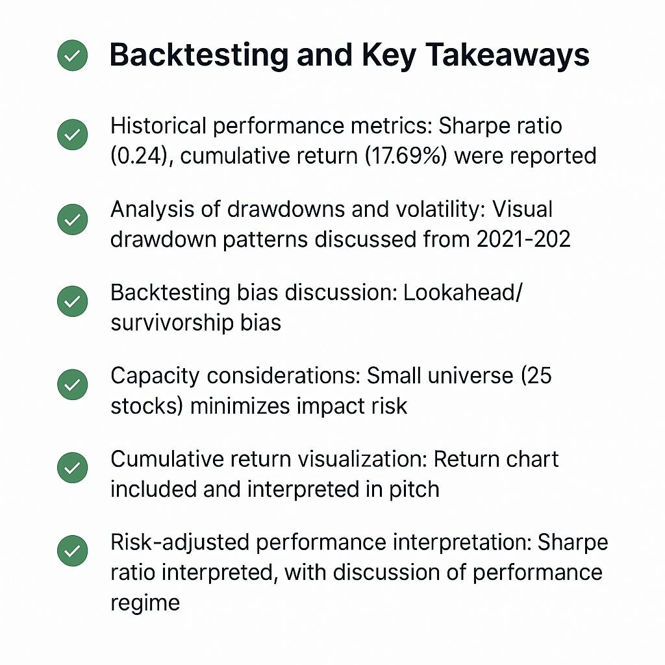

ALT 2025
Key Takeaways Checklist

Slide 11


ALT 2025
Final Conclusion
MEASURING MARKET PERFORMANCE
This strategy proves that with disciplined factor modeling, we can generate consistent signals from real-world data. Even without optimization, it showed meaningful returns. With smart enhancements, like volatility targeting and factor blending, this could evolve into a scalable, production-ready quant strategy.

Slide 12
ALT 2025
Thank You
CARIS ANTONY MAMPILLY (BTECH | PGDDS | MBA | MSFIN)
CARISANTONY@GMAIL.COM | +1.283.210.9609
ALGORITHMIC TRADING PROJECT 2025
GUIDANCE FROM PROF. MEHMET SAGLAM

